Slide 1
Cyber Security and Ethical Hacking

Slide 2
Blockchain

Slide 3
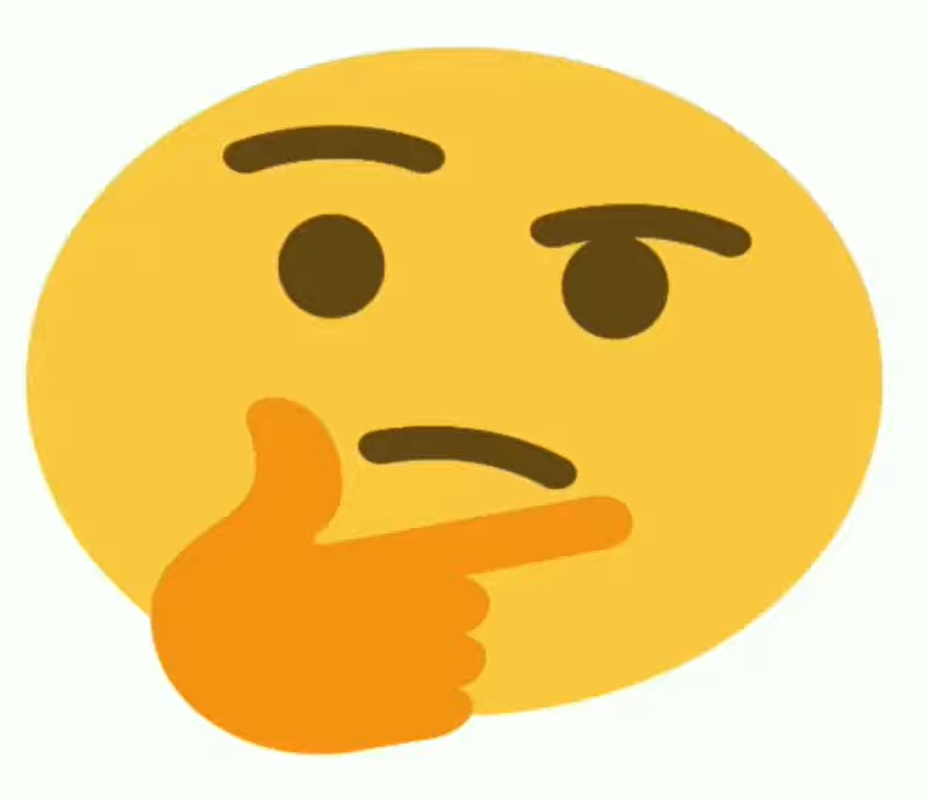
Why should I study Blockchain?

Slide 4
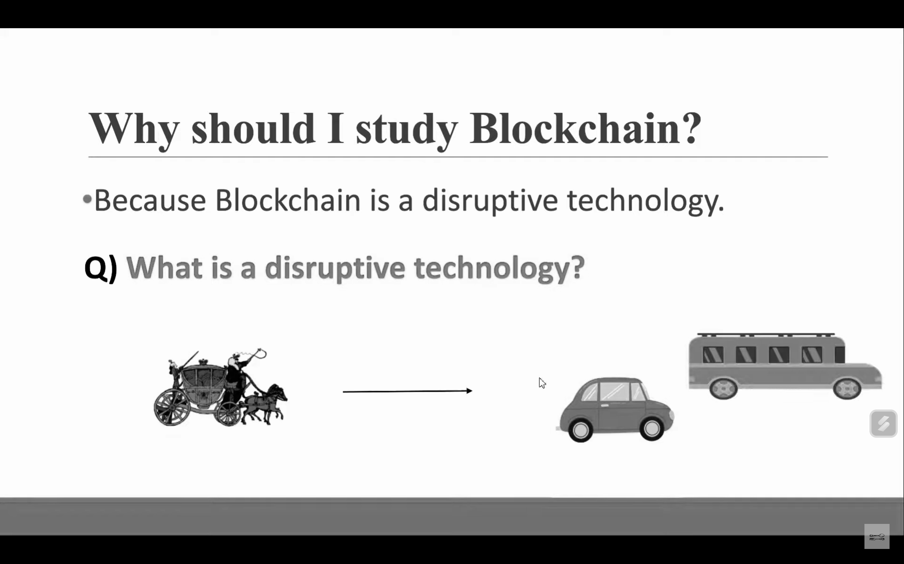
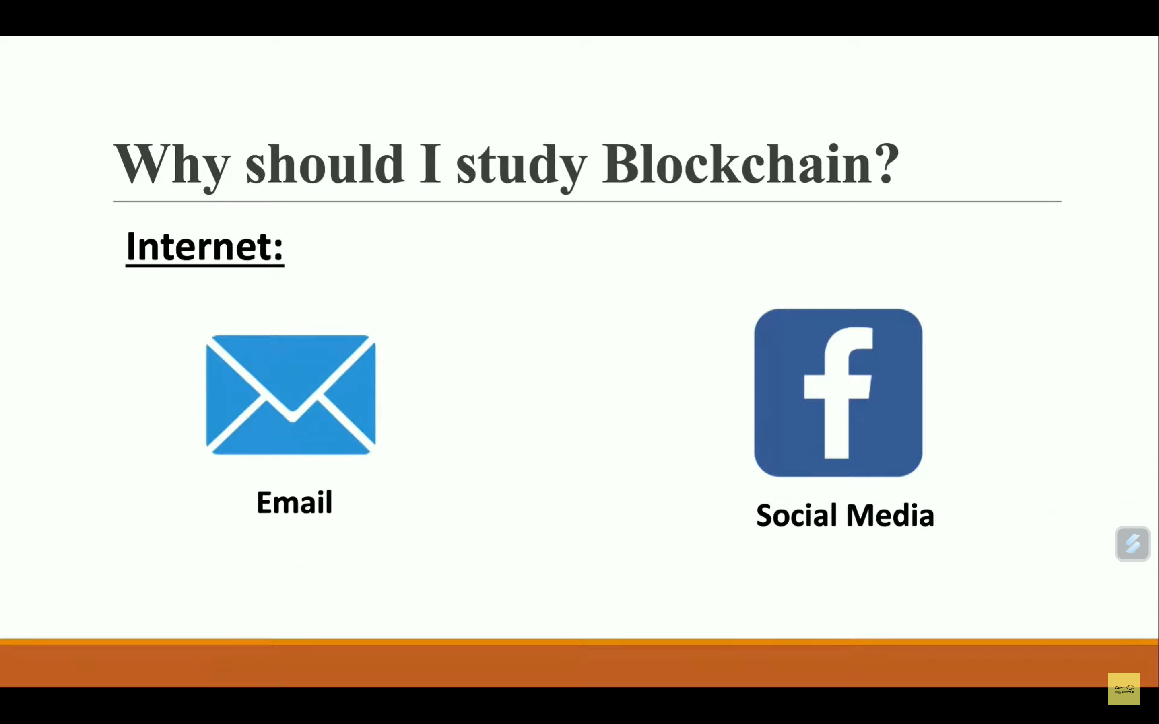
Why should I study Blockchain?
Because Blockchain is a disruptive technology.

Slide 5
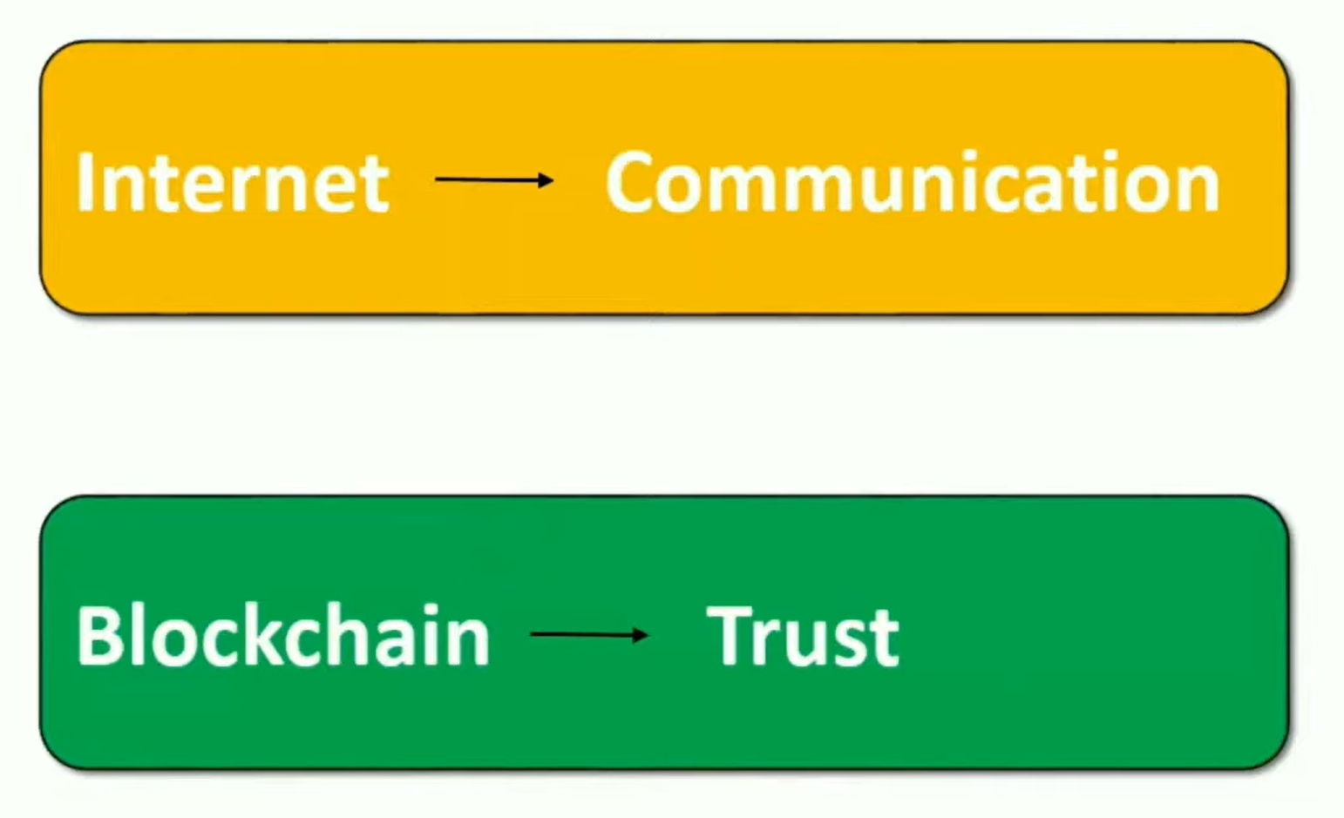
Why should I study Blockchain?
2008 financial crises.
Satoshi Nakamoto: Bit coin

Slide 6
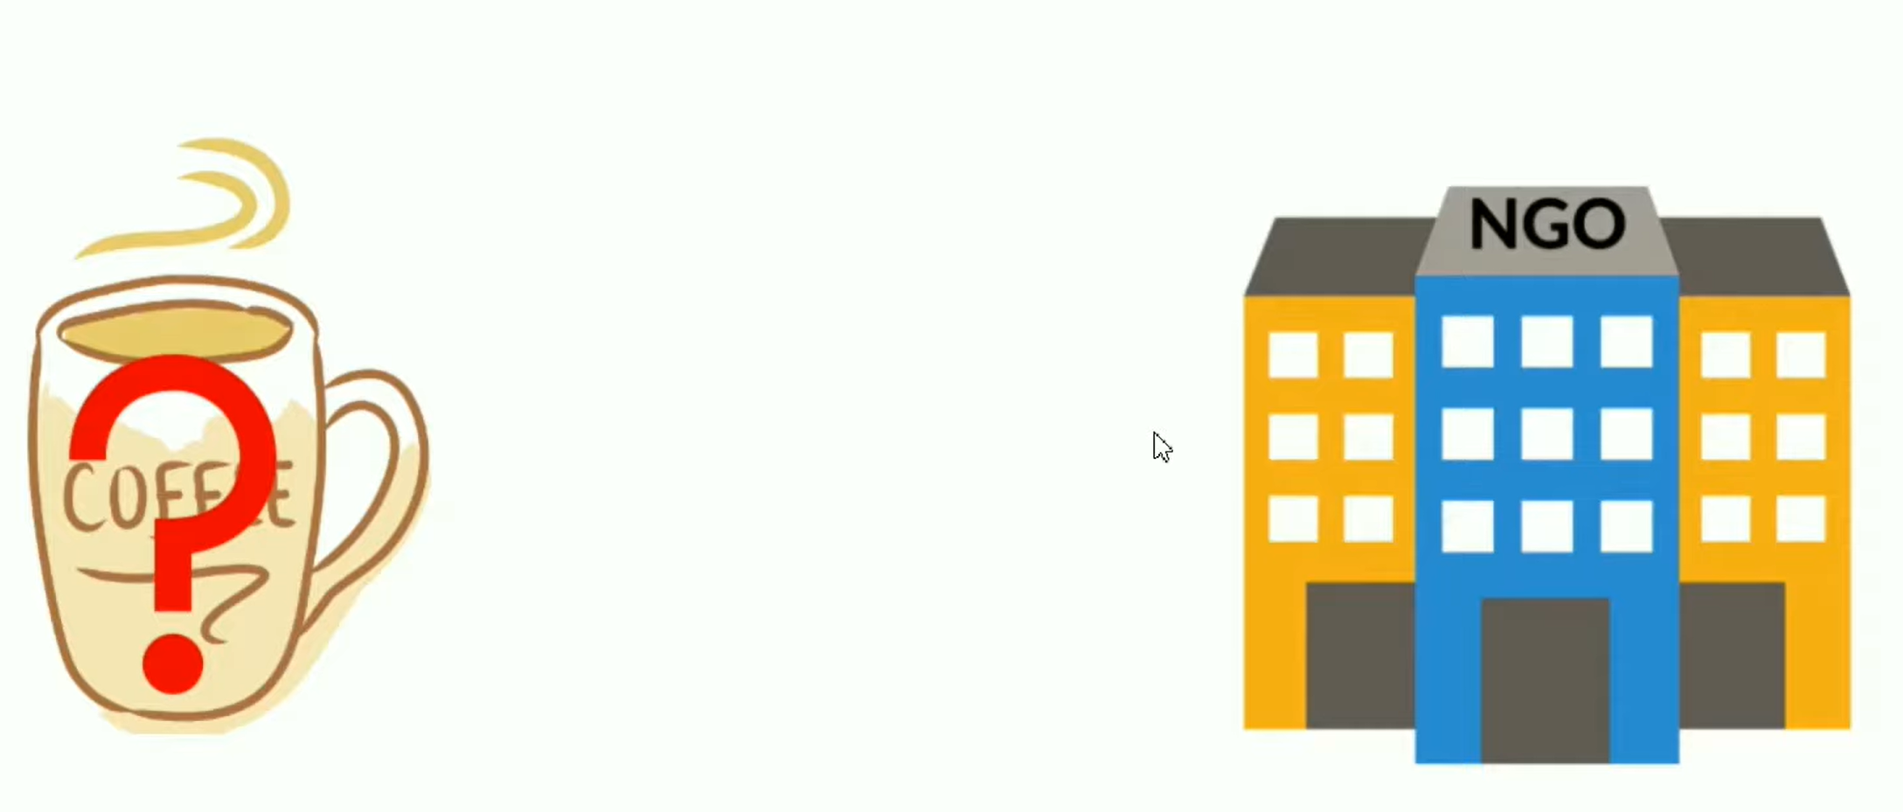
Why should I study Blockchain?

Slide 7
What is Blockchain?

Slide 8
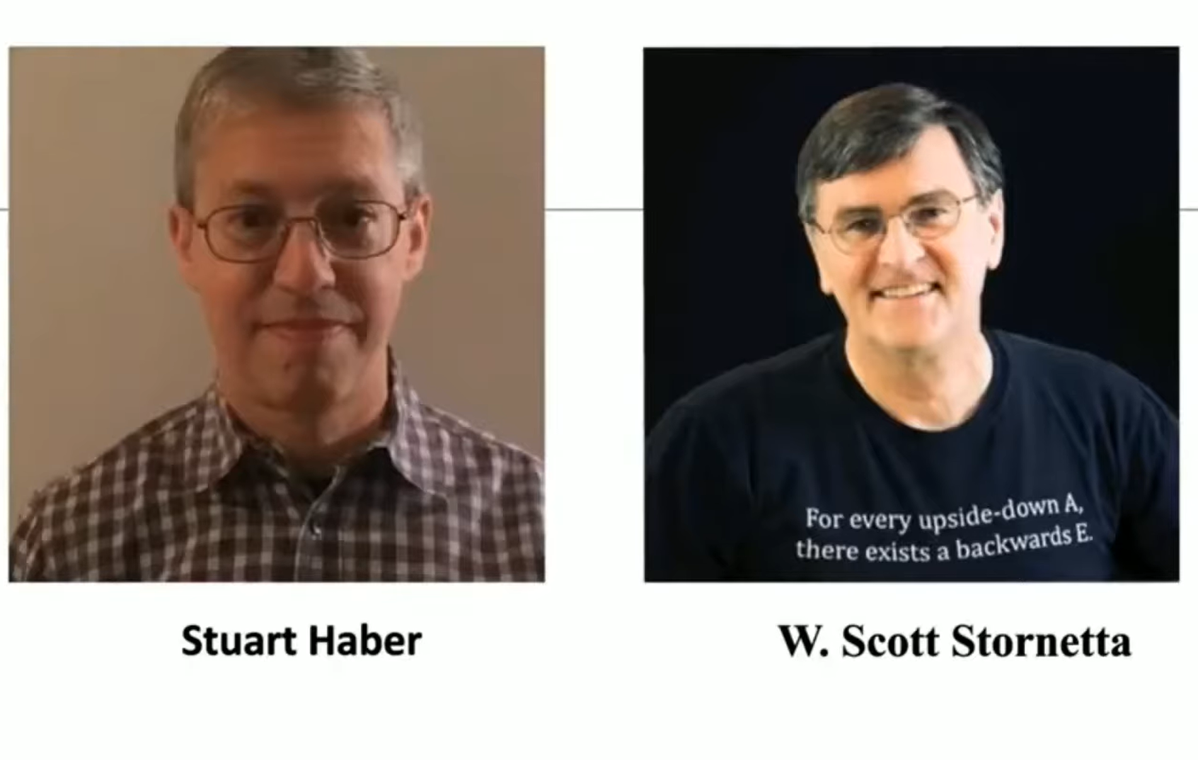
What is Blockchain?
In 1991, paper is published that is how to digital time stamp a document.
The idea of block chain is taken by this paper.

Slide 9
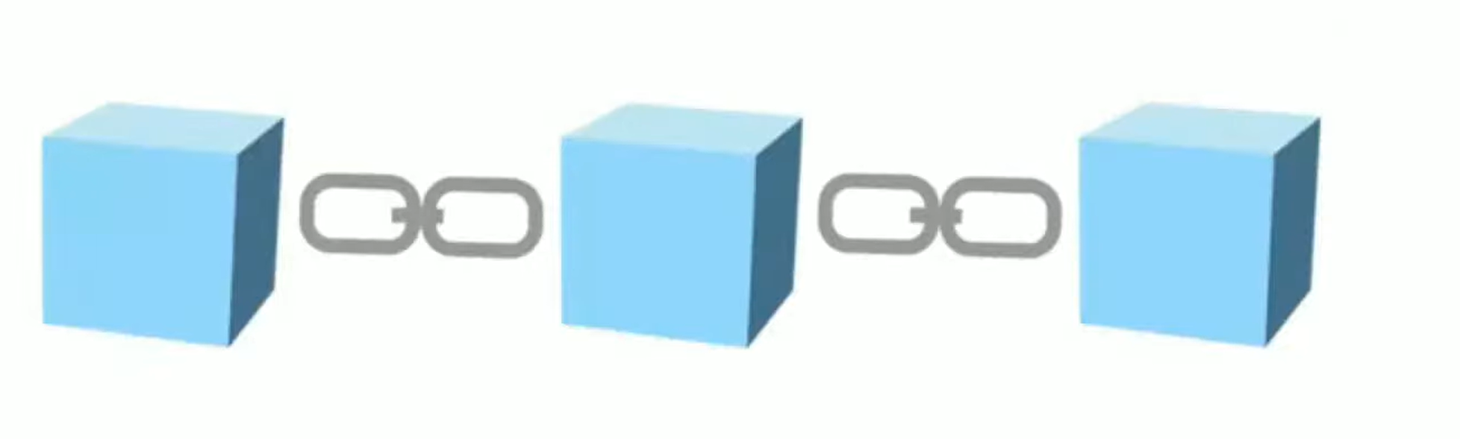
What is Blockchain?
Blockchain is a distributed immutable ledger which is completely transparent.

Slide 10
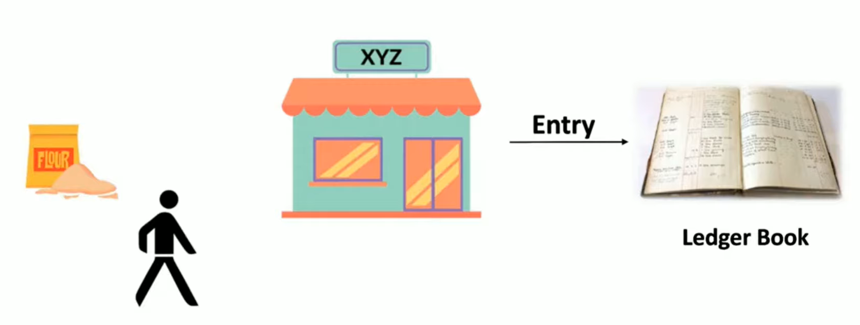
What is Blockchain?
Blockchain is a distributed immutable ledger which is completely transparent.

Slide 11
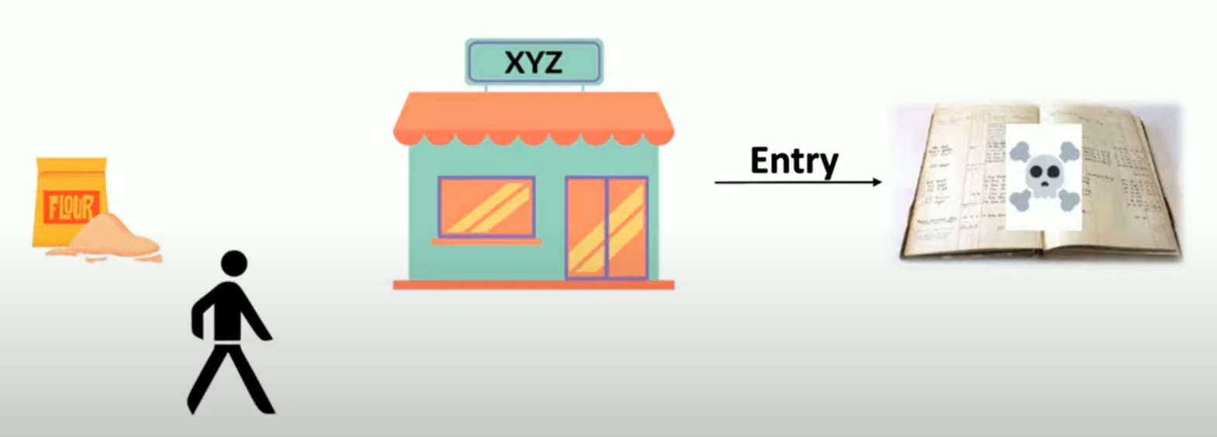
What is Blockchain?
Blockchain is a distributed immutable ledger which is completely transparent.

Slide 12
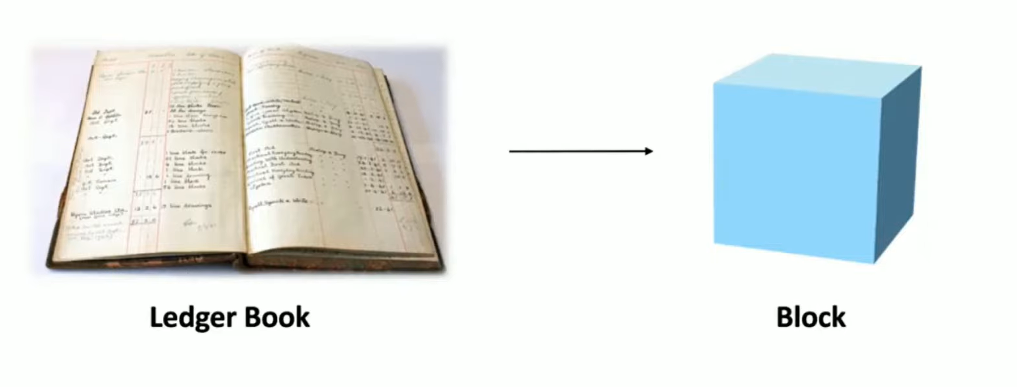
What is Blockchain?

Slide 13
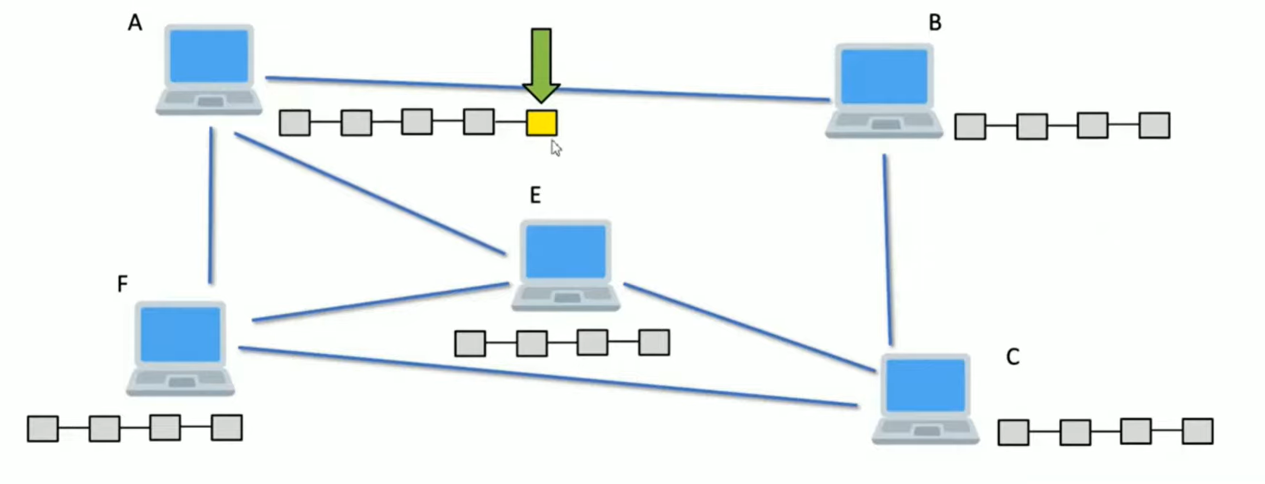
What is Blockchain?
Added a node in blockchain

Slide 14
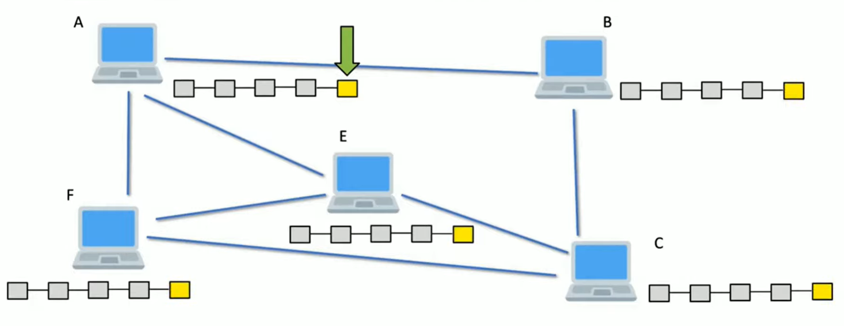
What is Blockchain?
Added a node in blockchain
So distributed.

Slide 15
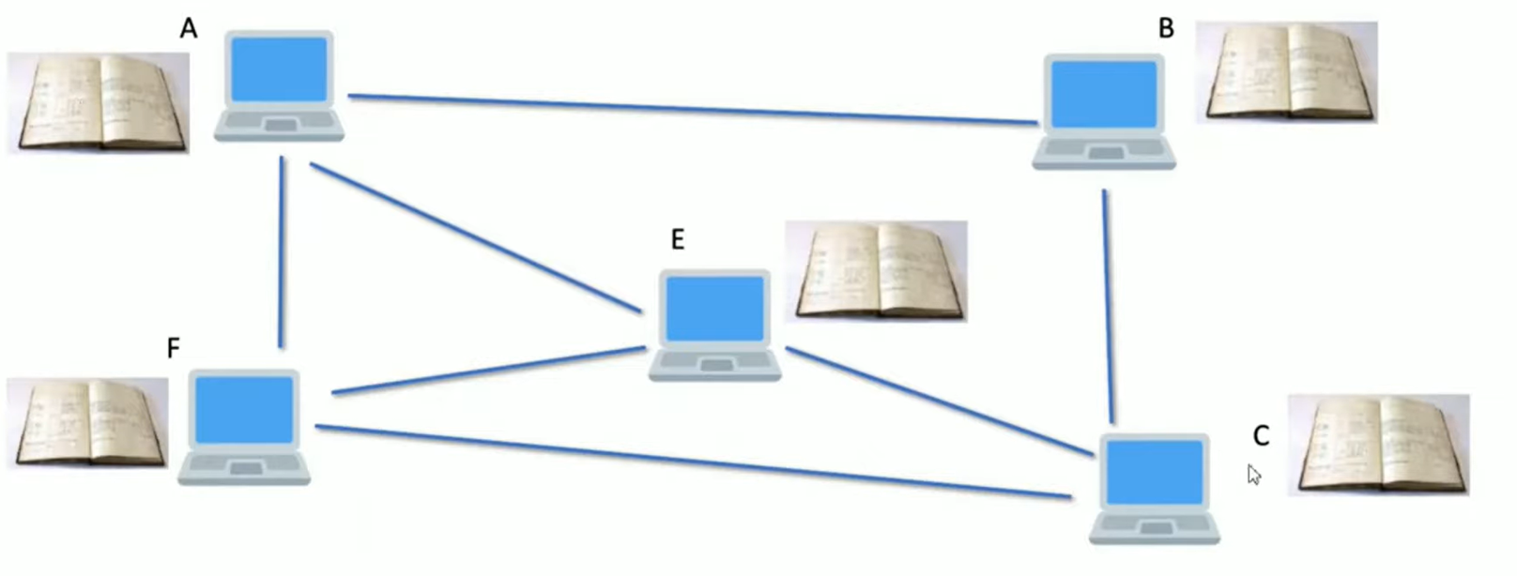
What is Blockchain?
Added a node in blockchain
So distributed.

Slide 16
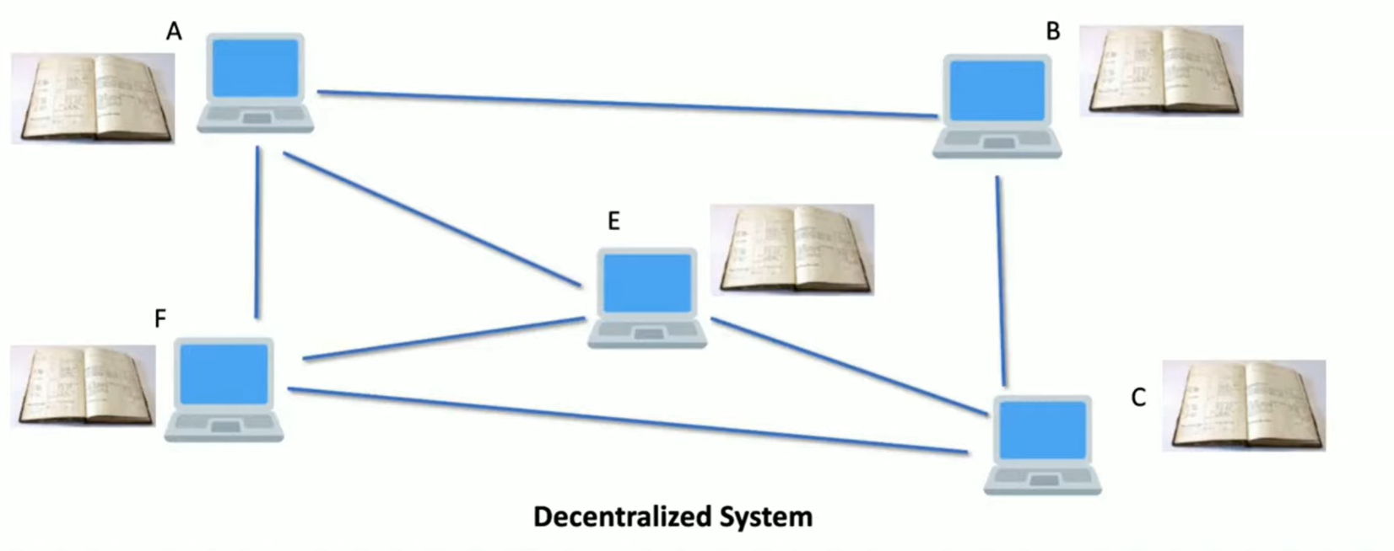
What is Blockchain?
Why transparent?
distributed

Slide 17
What is Blockchain?
Why transparent?
distributed: All transaction encrypted.

Slide 18
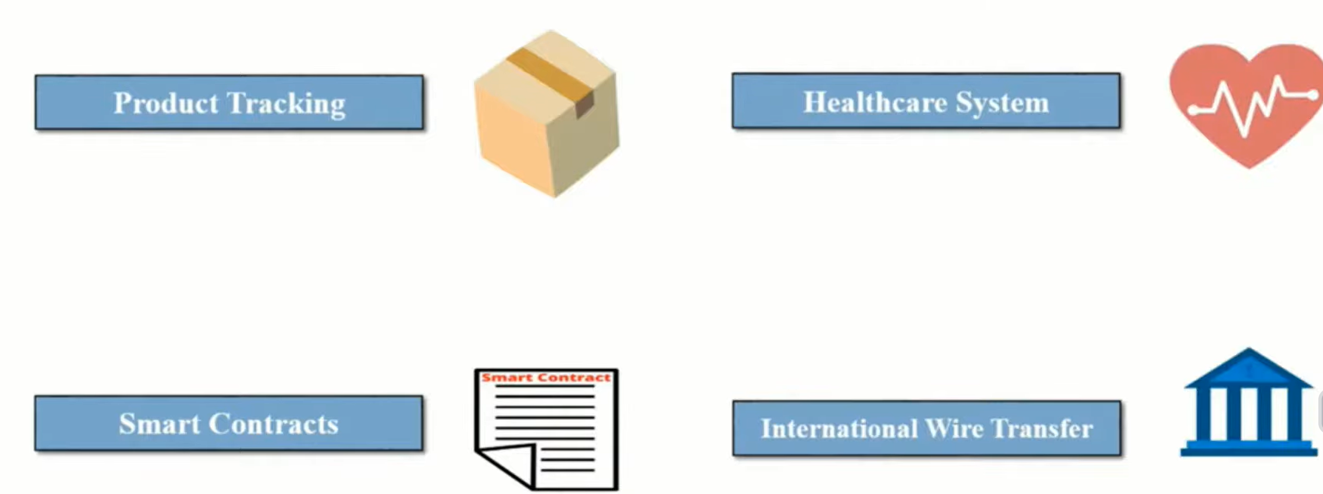
Application of Blockchain

Slide 19
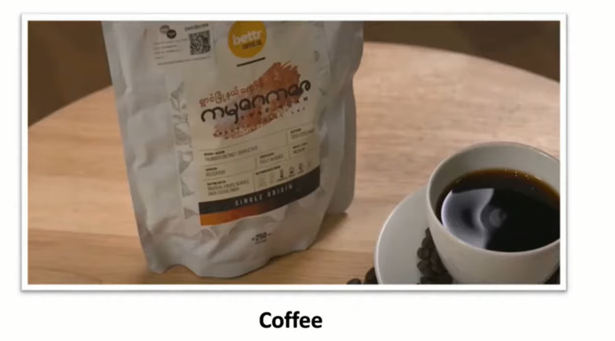
Application of Blockchain
Product tracking: Used in Denmark

Slide 20
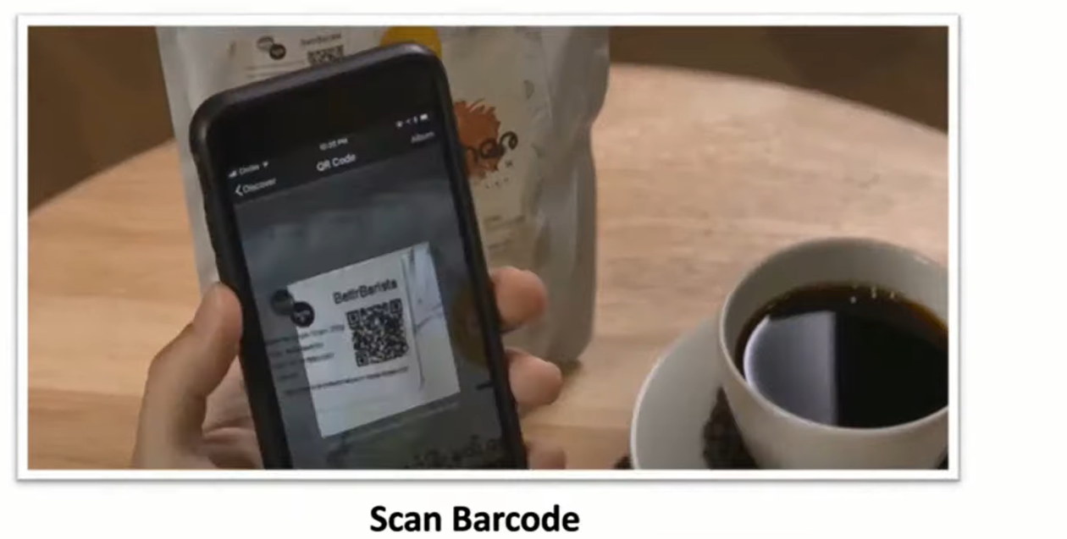
Application of Blockchain
Product tracking: Used in Denmark

Slide 21
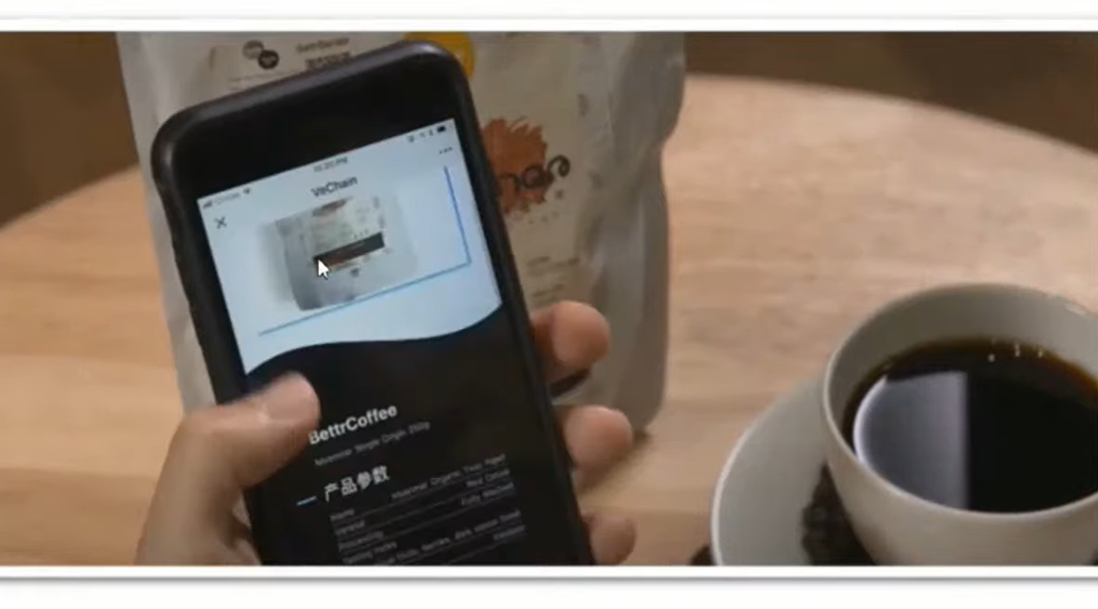
Application of Blockchain
Product tracking: Used in Denmark

Slide 22
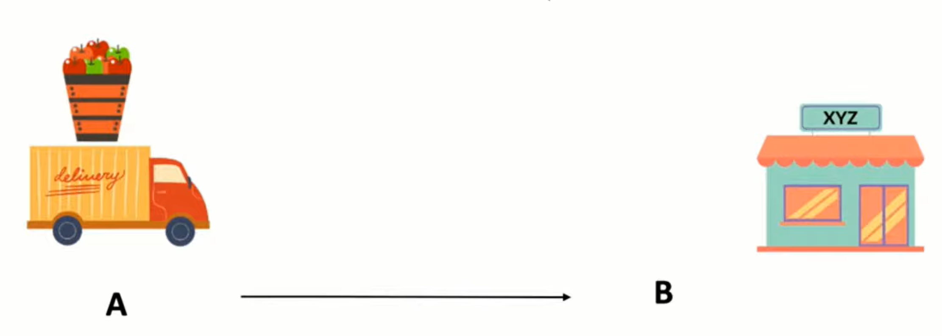
Smart contract
Smart contract is a program run on Ethereum blockchain.

Slide 23
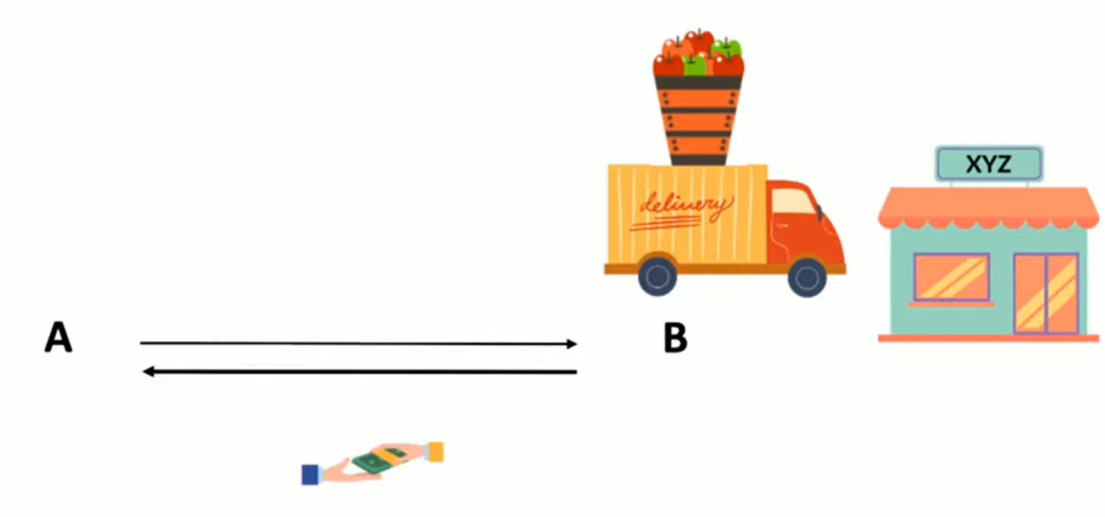
Smart contract

Slide 24
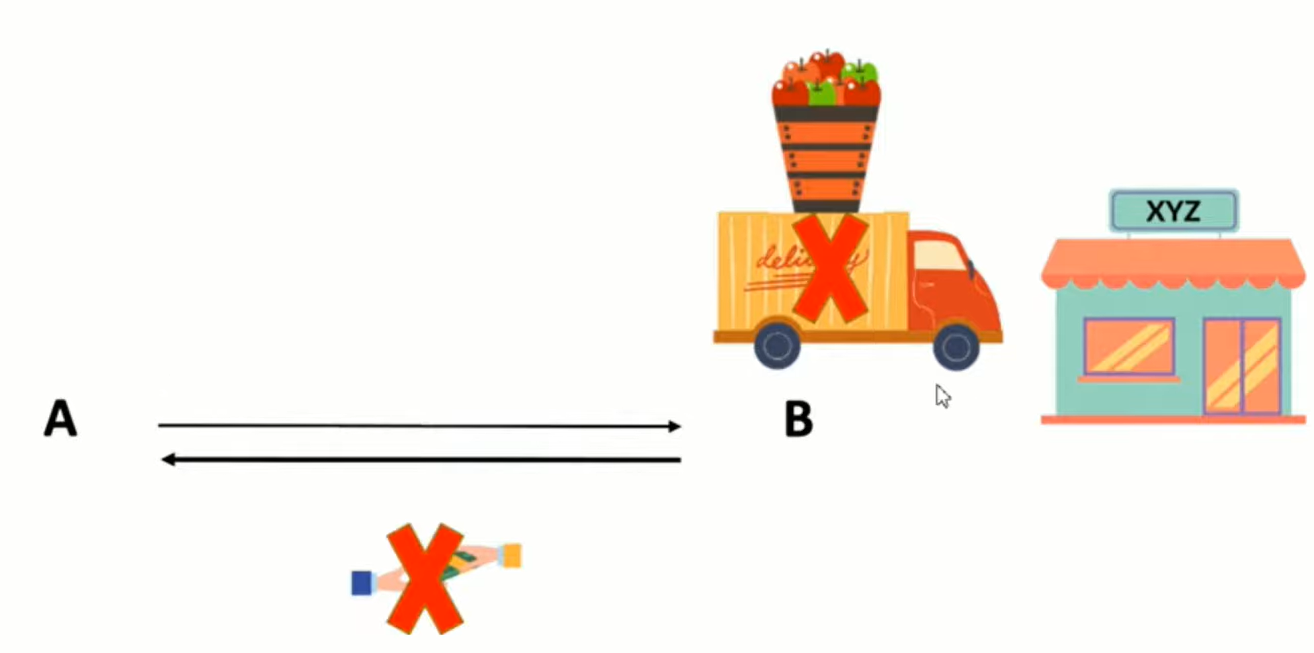
Smart contract

Slide 25
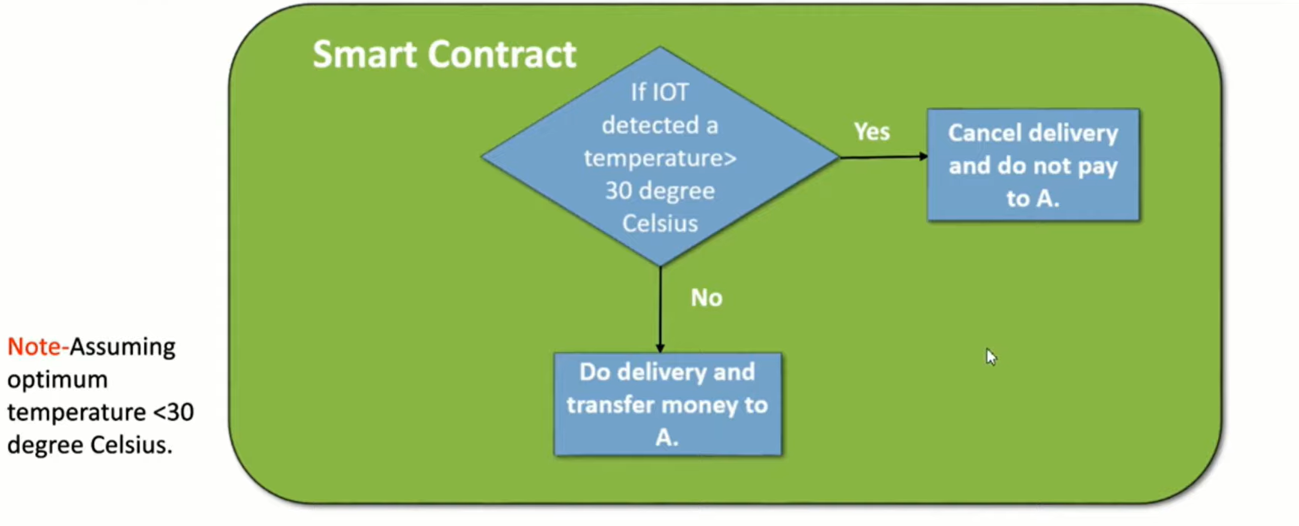
Smart contract

Slide 26
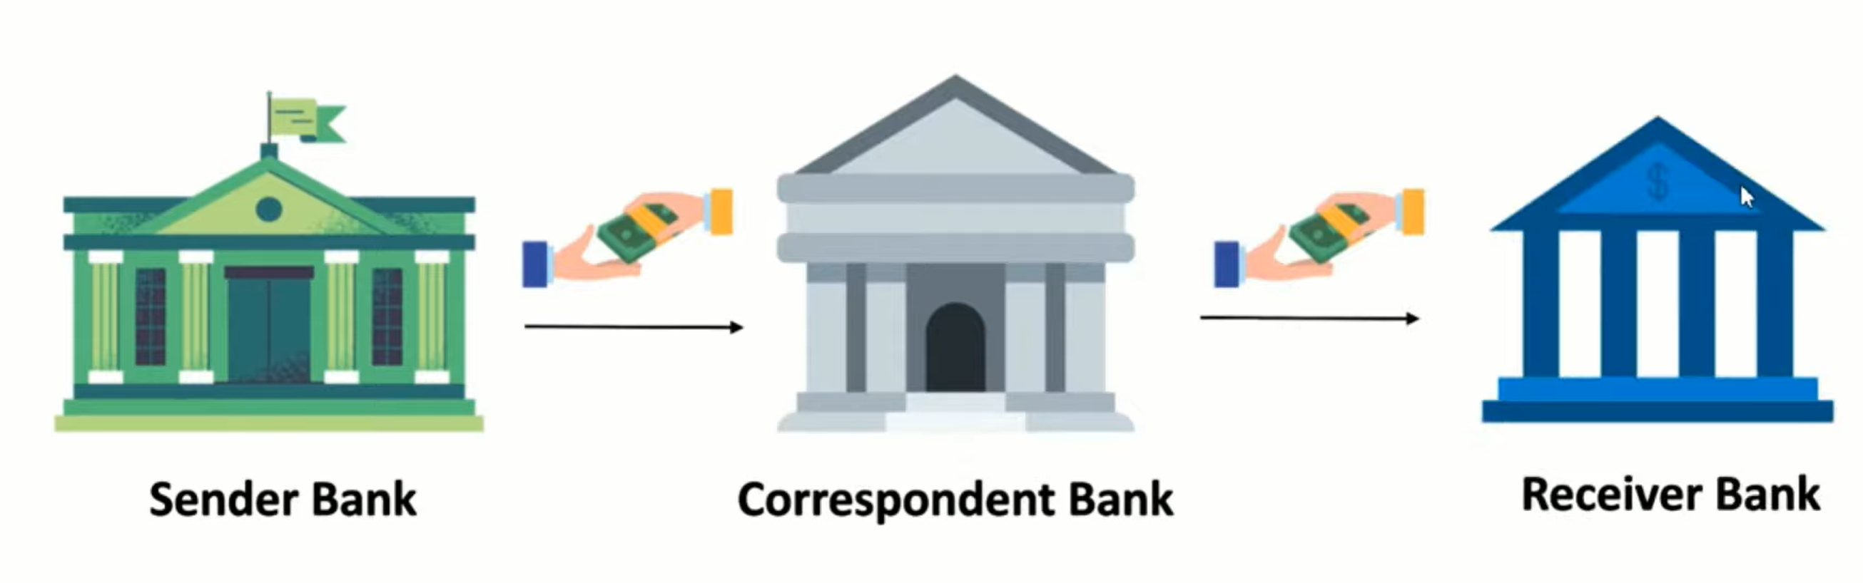
International Wire Transfer

Slide 27
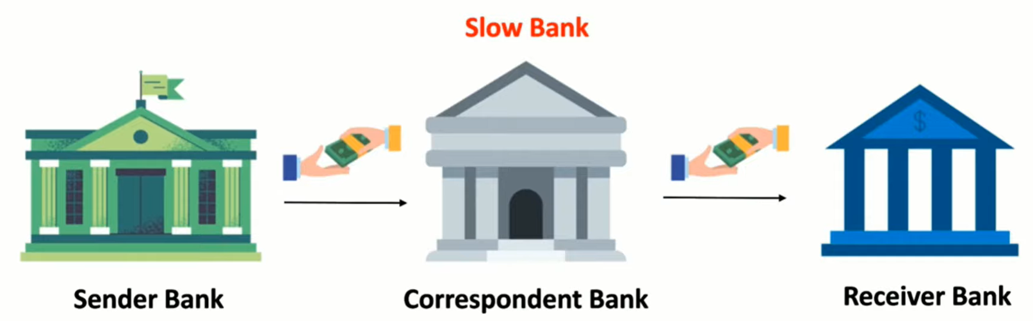
International Wire Transfer

Slide 28
Disadvantages of the centralized banking systems
Huge Fees
Time consuming

Slide 29
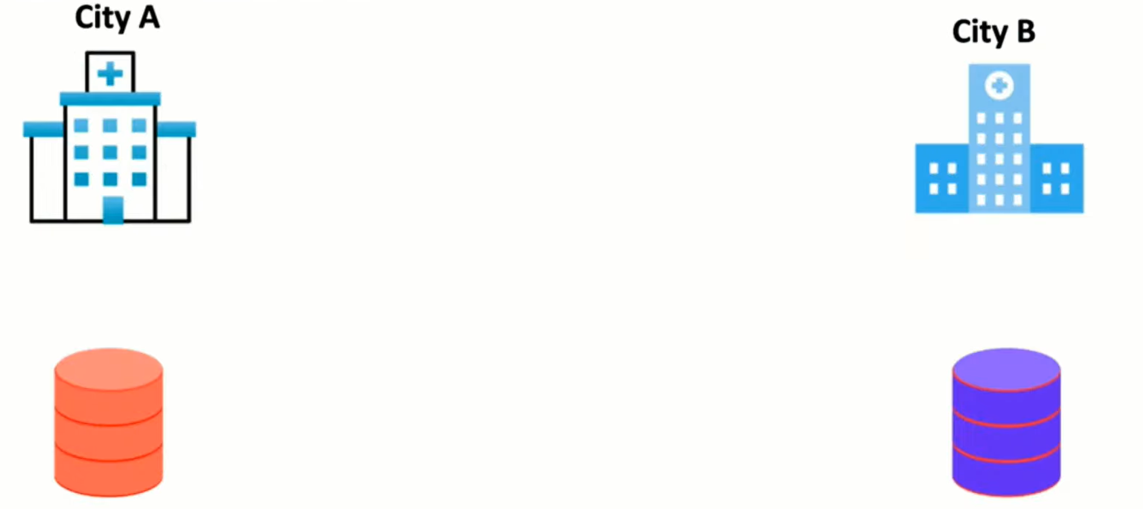
Healthcare System

Slide 30
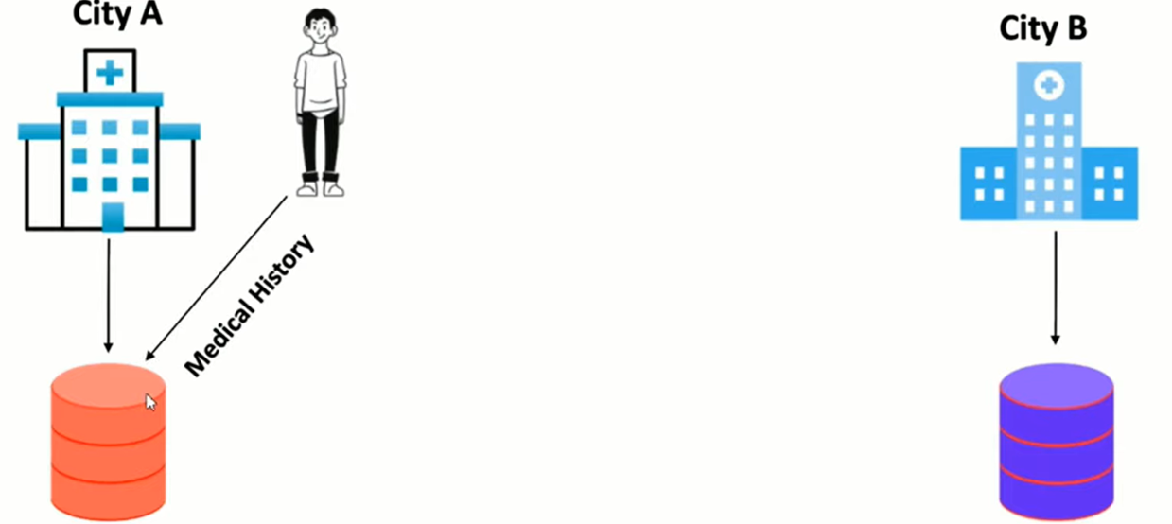
Healthcare System

Slide 31
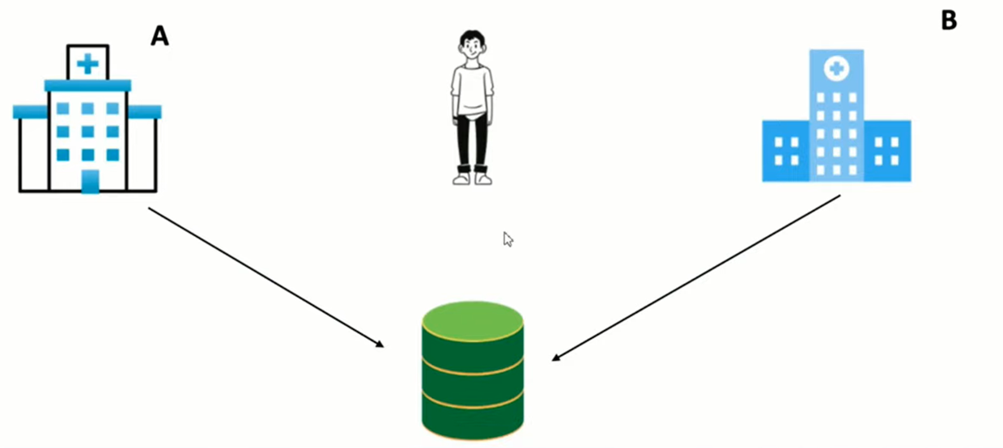
Healthcare System

Slide 32
Healthcare System
Task: Find at least five more application of blockchain.

Slide 33
Thankyou

